Slide 1

Let’s Git this Party Started Mark Bennett April 30th, 2019

Slide 2
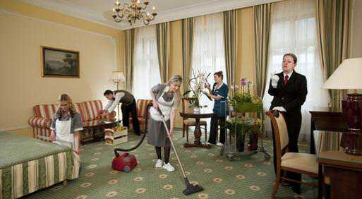
Housekeeping
Introductions
Next Meetup May 28th
MS Build May 6th to 8th
Wanted: Membership Director
Dev Edmonton Slack channel https://devedmonton.com/
News? Hiring or looking for work?
Notes:
Introduce yourself and other EDMUG executives.
Washrooms.
Next meetup is May 28th. Working on confirming the speaker. Looking for June and fall 2019 presenters.
Anyone want to be help us out as Membership Director? Help us
Discuss .NET on the Dev Edmonton Slack channel.
News? Anyone hiring or looking for work?

Slide 3

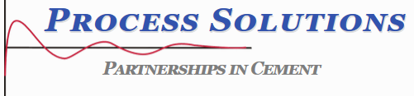

Thanks to Our Sponsors
Are you interested in being a sponsor? Let use know.
Notes:
Process Solutions, JetBrains. Any other sponsors?

Slide 4
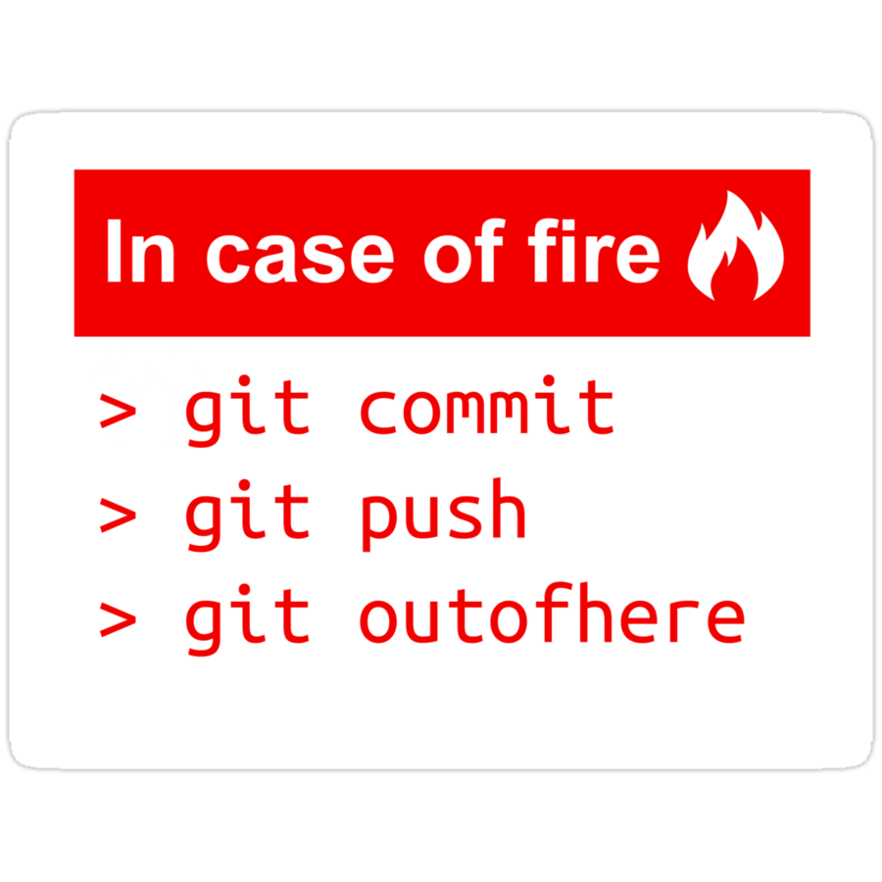
Let’s Git the Party Started!
Mark Bennett – Burmis Studio
Involved with DevEdmonton and Exchange.js
Developed software on Commodore 64
Notes:
Past EDMUG presentations:
- Secrets Management (Oct 2017)
Works at DevFacto.

Slide 5
Wrap-up
Survey and prize draw! Constructive feedback appreciated.
Next meetup: May 28th, 2018
Contact: info@edmug.net http://edmug.net
Notes:
Thank the presenter, sponsors, and members.

